Slide 1
THE RESPIRATORY SYSTEM

Slide 2
1. List the characteristics of living things. (Remember MRS GREN)
2. Write the word equation for photosynthesis.
How do you think you are doing in 8 Science? What grade do you think you are sitting on?

Slide 3
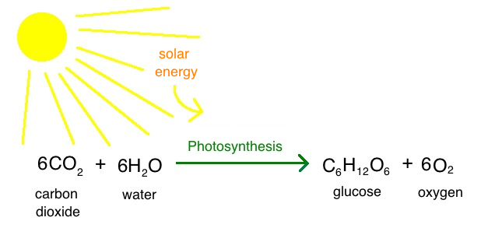

Slide 4
I can describe the structure of each organ in the respiratory system and relate its function to the overall function of the system.
I know what gas exchange is and how it occurs

Slide 5
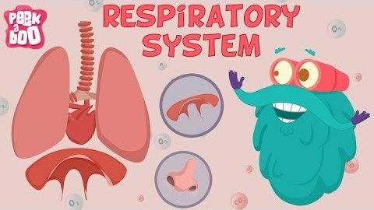
List the parts of the respiratory system.

Slide 6
Pulmonary
Relating to the lungs.

Slide 7

Respiration
The process in living organisms involving the production of energy with the intake of oxygen and the release of carbon dioxide.

Slide 8
I can describe the structure of each organ in the respiratory system and relate its function to the overall function of the system.
I know what gas exchange is and how it occurs
Knowing the function of the circulatory system, we need to understand more about how oxygen is carried into the blood to start with.
In order for something to be living, it must have all of the characteristics of life (MRS GREN)
One of these characteristics is respiration, which is how organisms produce their energy.
Respiration - the process in living organisms involving the production of energy with the intake of oxygen and the release of carbon dioxide.

Slide 9
I can describe the structure of each organ in the respiratory system and relate its function to the overall function of the system.
I know what gas exchange is and how it occurs
Knowing the function of the circulatory system, we need to understand more about how oxygen is carried into the blood to start with.
The function of the circulatory system is to carry oxygen and nutrients to cells and carry waste away from them.
Pulmonary arteries and veins carry blood between the heart and lungs.
Respiration - the process in living organisms involving the production of energy with the intake of oxygen and the release of carbon dioxide.

Slide 10
I can describe the structure of each organ in the respiratory system and relate its function to the overall function of the system.
I know what gas exchange is and how it occurs
What is the respiratory system?
The respiratory system consists of all the organs involved in breathing.
Many
People
Love
Taylor’s
Bad
Blood
Album
Mouth
Pharynx
Larynx
Trachea
Bronchi
Bronchiole
Alveoli

Slide 11
I can describe the structure of each organ in the respiratory system and relate its function to the overall function of the system.
I know what gas exchange is and how it occurs
What is the respiratory system?
Many
People
Love
Taylor’s
Bad
Blood
Album
Mouth
Pharynx
Larynx
Trachea
Bronchi
Bronchiole
Alveoli

Slide 12
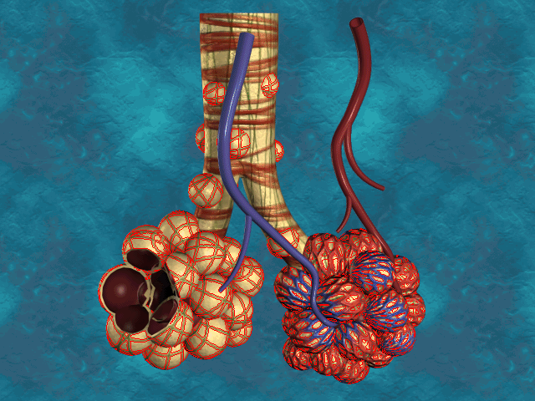
I can describe the structure of each organ in the respiratory system and relate its function to the overall function of the system.
I know what gas exchange is and how it occurs
What are alveoli?
What is gas exchange?
When air is breathed in, it is moistened, warmed and filtered until it reaches the alveoli.
Alveoli are tiny, thin-walled sacs where gas exchange occurs.
Many
People
Love
Taylor’s
Bad
Blood
Album
Mouth
Pharynx
Larynx
Trachea
Bronchi
Bronchiole
Alveoli
Gas exchange – delivery of oxygen from the lungs to the bloodstream and the elimination of carbon dioxide from the bloodstream to the lungs.

Slide 13
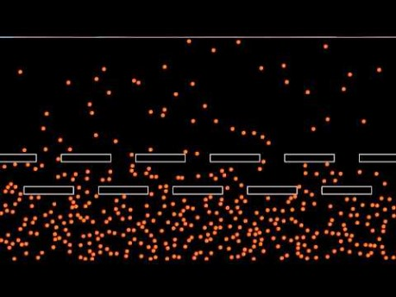
I can describe the structure of each organ in the respiratory system and relate its function to the overall function of the system.
I know what gas exchange is and how it occurs
What are alveoli?
What is gas exchange?
Gas exchange occurs when oxygen and carbon dioxide diffuse across a membrane, from an area of high concentration to an area of low concentration.
Many
People
Love
Taylor’s
Bad
Blood
Album
Mouth
Pharynx
Larynx
Trachea
Bronchi
Bronchiole
Alveoli
Gas exchange – delivery of oxygen from the lungs to the bloodstream and the elimination of carbon dioxide from the bloodstream to the lungs.

Slide 14
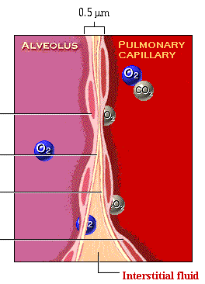
I can describe the structure of each organ in the respiratory system and relate its function to the overall function of the system.
I know what gas exchange is and how it occurs
What are alveoli?
What is gas exchange?
Many
People
Love
Taylor’s
Bad
Blood
Album
Mouth
Pharynx
Larynx
Trachea
Bronchi
Bronchiole
Alveoli
Gas exchange – delivery of oxygen from the lungs to the bloodstream and the elimination of carbon dioxide from the bloodstream to the lungs.

Slide 15
I can describe the structure of each organ in the respiratory system and relate its function to the overall function of the system.
I know what gas exchange is and how it occurs
Which part of the respiratory system does air go through first: bronchi or bronchioles?
Which part of the respiratory system does air go through first: bronchi or bronchioles?
Many
People
Love
Taylor’s
Bad
Blood
Album
Mouth
Pharynx
Larynx
Trachea
Bronchi
Bronchiole
Alveoli

Slide 16
I can describe the structure of each organ in the respiratory system and relate its function to the overall function of the system.
I know what gas exchange is and how it occurs
Which part of the respiratory system is the smallest?
Which part of the respiratory system is the smallest?
Many
People
Love
Taylor’s
Bad
Blood
Album
Mouth
Pharynx
Larynx
Trachea
Bronchi
Bronchiole
Alveoli

Slide 17
I can describe the structure of each organ in the respiratory system and relate its function to the overall function of the system.
I know what gas exchange is and how it occurs
Which part of the respiratory system holds the vocal chords?
Which part of the respiratory system holds the vocal chords?
Many
People
Love
Taylor’s
Bad
Blood
Album
Mouth
Pharynx
Larynx
Trachea
Bronchi
Bronchiole
Alveoli

Slide 18
I can describe the structure of each organ in the respiratory system and relate its function to the overall function of the system.
I know what gas exchange is and how it occurs
Which part of the respiratory system is the first part that air enters?
Which part of the respiratory system is the first part that air enters?
Many
People
Love
Taylor’s
Bad
Blood
Album

Slide 19
I can describe the structure of each organ in the respiratory system and relate its function to the overall function of the system.
I know what gas exchange is and how it occurs
Which part of the respiratory system is the first part that carbon dioxide enters?
Which part of the respiratory system is the first part that carbon dioxide enters?
Many
People
Love
Taylor’s
Bad
Blood
Album

Slide 20
I can describe the structure of each organ in the respiratory system and relate its function to the overall function of the system.
I know what gas exchange is and how it occurs
What is the name of the cavity behind the nose and mouth?
What is the name of the cavity behind the nose and mouth?
Many
People
Love
Taylor’s
Bad
Blood
Album

Slide 21
I can describe the structure of each organ in the respiratory system and relate its function to the overall function of the system.
I know what gas exchange is and how it occurs
What is the name for the wind pipe?
What is the name for the wind pipe?
Many
People
Love
Taylor’s
Bad
Blood
Album

Slide 22
I can describe the structure of each organ in the respiratory system and relate its function to the overall function of the system.
I know what gas exchange is and how it occurs
Why is knowing about the respiratory system and how it works important?
We all have a respiratory system! It is possible, likely even, that you will at some point need to understand how it works in order to make decisions about your, or someone else’s, health.
The respiratory system works with the circulatory system to ensure that oxygen reaches cells and carbon dioxide is removed.

Slide 23
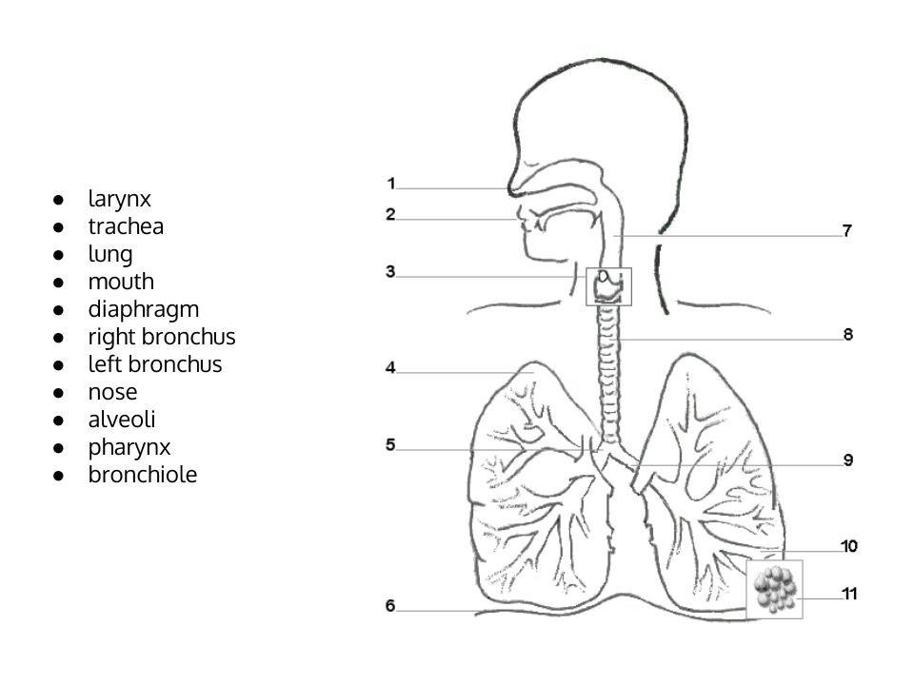
Copy and fill out

Slide 24
I can describe the structure of each organ in the respiratory system and relate its function to the overall function of the system.
I know what gas exchange is and how it occurs
Many
People
Love
Taylor’s
Bad
Blood
Album
Mouth
Pharynx
Larynx
Trachea
Bronchi
Bronchiole
Alveoli
Complete the worksheet and glue it into your book.

Slide 25


Slide 26
I can describe the structure of each organ in the respiratory system and relate its function to the overall function of the system.
I know what gas exchange is and how it occurs

